Slide 1
COMPUTATIONAL LOGIC
Horvath David-Cristian, Group 913
INDIVIDUAL HOMEWORK

Slide 2
THEORY

Slide 3
Conjunctive formulas, which are consistent only if both of its component sub-formulas are satisfied, are decomposed using α - rules
A ∧ B
|
A
|
B
¬ (A ∨ B) ≡ ¬A ∧ ¬B
|
¬A
|
¬B
¬ (A → B) ≡ A ˄ ¬B
|
A
|
¬B

Slide 4
Disjunctive formulas, which are satisfied if one of its component sub-formulas is satisfiable (consistent), are decomposed using β - rules
A ∨ B
/ \
A B
¬ (A ˄ B) ≡ ¬A ∨ ¬B
/ \
¬A ¬B
A → B ≡ ¬A ∨ B
/ \
¬A B

Slide 5
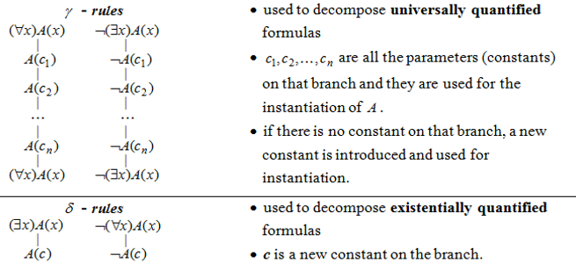
DECOMPOSITION RULES FOR PREDICATE FORMULAS

Slide 6
CONSTRUCTION OF A SEMANTIC TABLEAU
To a propositional / predicate formula U we can associate a semantic tableau, which is a binary tree having formulas in its nodes and it is built as follows:
the root of the tree is labeled with the initial formula;
every branch of the tree which contains a formula will be extended with a subtree according to the decomposition rule specific to its class;
the extension of a branch stops in the following cases:
if that branch contains a formula and its negation, the branch is marked as closed using the symbol ⦻ ;
if all the formulas on that branch are already decomposed or if by decomposing the formulas which are not decomposed yet, no new formulas are obtained.

Slide 7
DEFINITIONS
1. A branch of a semantic tableau is called closed (marked by ⦻) if it contains a formula and its negation.
A branch is called complete if it is closed or all the formulas on that branch are already decomposed.
3. A branch is called open (marked by the symbol ⊙) if it is complete but not closed.
4. A semantic tableau is called closed if all its branches are closed.
5. If a semantic tableau has at least one open branch, the tableau is called open.
6. A semantic tableau is called complete if all its branches are complete.

Slide 8
THEORETICAL RESULTS
THEOREM 1: Soundness and completeness of the semantic tableaux method
A propositional/predicate formula U is a tautology if and only if ¬U has a closed semantic tableau.
THEOREM 2:
Let U1, U2, … , Un, V be propositional/predicate formulas.
U1, U2, … , Un |= V if and only if there is a closed semantic tableau associated to the formula: U1^U2^…^Un^ ¬V

Slide 9
EXERCISE 5.3
Using the semantic tableaux method, prove that ‘∃’ is semi-distributive over ‘→’ in the following case:
⊨((∃x)A(x)→(∃x)B(x))→(∃x)(A(x)→B(x)) and
⊭(∃x)(A(x)→B(x))→((∃x)A(x)→(∃x)B(x))

Slide 10




¬U₁ ₌ ¬(((∃x)A(x)→(∃x)B(x)) →(∃x)(A(x)→B(x))) (1)
| α rule for (1)
(∃x)A(x)→(∃x)B(x) (2)
|
(3) ≡ (∀x) $¬(¬$A(x) ∨ B(x));
¬(∃x)(A(x)→B(x)) (3)
β rule for (2)
¬(∃x)A(x) (4)
(∃x)B(x) (5)
γ rule for (4), b = new constant |
| δ rule for (5), a = new constant
¬A(b)
B(a)
|
| γ rule for (3), a = used for instantiation
copy for formula (4), ¬(∃x)A(x)
$¬(¬$A(a) ∨ B(a)) (7)
γ rule for (3), b = used for instantiation |
|
$¬(¬$A(b) ∨ B(b)) (6)
(∀x) $¬(¬$A(x) ∨ B(x)), copy for formula (3)
|
copy for formula (3), (∀x) $¬(¬$A(x) ∨ B(x))
| α rule for (7)
| α rule for (6)
A(a)
A(a)
|
|
¬B(a)
All branches of the semantic tableau are closed, containing pairs of opposite literals.
Therefore, the formula ¬U₁ has no models, so it is an inconsistent formula.
We conclude that U₁ is a tautology.
¬B(a)
⦻ closed branch
⦻ closed branch

Slide 11
¬U₂ ₌ ¬((∃x)(A(x)→B(x))→((∃x)A(x)→(∃x)B(x))) (1)
| α rule for (1)
(∃x)(A(x)→B(x)) (2)
|
¬((∃x)A(x)→(∃x)B(x)) (3)
| α rule for (3)
(∃x)A(x) (4)
|
¬(∃x)B(x) (5)
| δ rule for (4), a = new constant
A(a)
| γ rule for (5), a = used for instantiation
¬B(a)
We have obtained a complete and open tableau
with one open branch.
Therefore U₂ is not a tautology.
|
¬(∃x)B(x) copy for formula (5)
| δ rule for (2), b = new constant
A(b)→B(b) (6)
|
β rule for (6)
¬A(a)
B(a)
⦻ closed branch
⊙ open branch

Slide 12
CONCLUSION
We proved ⊨U₁ and ⊭U₂ so that ’∃’ is semi-distributive over ’ →’.

